Slide 1
Introduction to Mass Communication
LECTURE 1

Slide 2
MASS COMMUNICATION
Mass communication is a process in which a person, group of people, or an organization sends a message through a channel of communication to a large group of anonymous and heterogeneous people and organizations.
You can think of a large group of anonymous and heterogeneous people as either the general public or a segment of the general public.
Channels of communication include broadcast television, radio, social media, and print.
The sender of the message is usually a professional communicator that often represents an organization.

Slide 3
https://www.youtube.com/watch?v=PUYeo7YjzYc

Slide 4
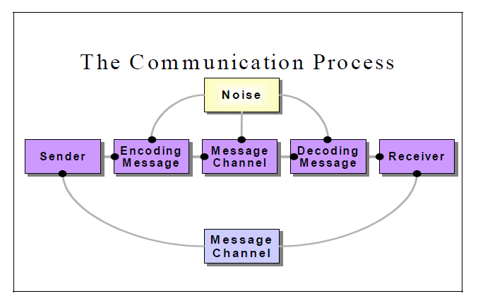
The model of communication

Slide 5
communication
Communication is a process beginning with a sender who encodes the message and passes it through some channel to the receiver who decodes the message.
Communication is fruitful if and only if the messages sent by the sender are interpreted with same meaning by the receiver.
If any kind of disturbance blocks any step of communication, the message will be destroyed. Due to such disturbances, managers in an organization face severe problems
For example: Dawn newspaper issues apology for publishing wrong piece.

Slide 6
There are many reasons why interpersonal communications may fail.
In many communications, the message (what is said) may not be received exactly the way the sender intended.
It is, therefore, important that the communicator seeks feedback to check that their message is clearly understood.

Slide 7
With communication comes barriers?
There are many barriers to communication and these may occur at any stage in the communication process.
Barriers may lead to your message becoming distorted and you therefore risk wasting both time and/or money by causing confusion and misunderstanding.

Slide 8
Language/semantic
Semantics, or code noise, occurs when the meaning of a message to the sender differs from its meaning to the recipient.
Too often, this may be the result of “jargon,” involving pretentious terminology or language specific to a particular profession or group.
For example, Unclear message, Faulty translation, Unclassified assumptions etc

Slide 9
Physical barriers
They occur due to the nature of the environment. Thus, for example, staff are located in different buildings or on different sites within an organisation.
Likewise, poor or outdated equipment, particularly the failure of management to introduce new technology, may also cause problems. For Example, Defects in media (letters,courier,fax,)
Noise in Environment (Air vibration, people talking, in factory because of noise the oral communication is difficult)

Slide 10
Cultural/ social barriers
Such barriers to communication include the social psychological phenomenon of conformity; a process in which the norms, values and behaviors' of an individual begin to follow those of the wider group
For Example: Some people may find it difficult to express their emotions and some topics may be completely 'off-limits' or taboo (mental illness, women issues, etc)

Slide 11
Psychological Barriers
Try to understand the receiver’s mental make-up and attitudes.
Perception of Reality: Try to understand the different levels of perceptions of a situation and an issue. Be open, flexible and transparent
For example: Depiction of violence on media

Slide 12
Overcoming Communication Barriers
Use of Simple Language
Active Listening
Avoid Information Overload
Give Constructive Feedback
Proper Media Selection

Slide 13
Assignment
Look for more barriers people are facing in the media organization and in digital age!

